Slide 1

FAST FOURIER TRANSFORM
Prof. Zhenyu He
Harbin Institute of Technology (Shenzhen)

Slide 2
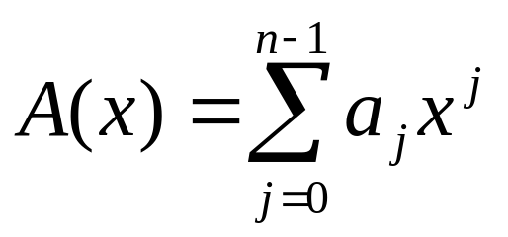
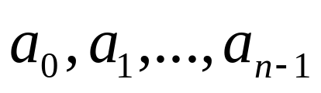

Polynomials
A polynomial in the variable x over an algebraic field F is a
representation of a function A(x) as a formal sum,
Where,
are the coefficients of the polynomial.
Degree of A(x) is k if the highest nonzero coefficient
is .
Obviously, n is the degree bound of A(x).

Slide 3
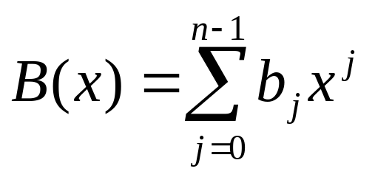
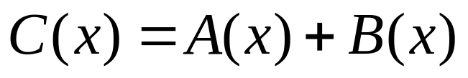
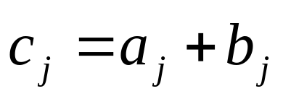
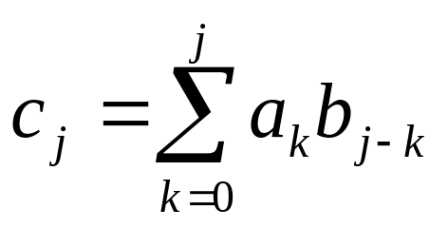
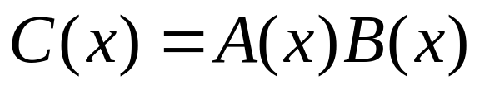
Polynomial addition and multiplication
and
If
,then
If
,then

Slide 4
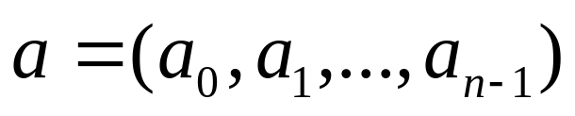
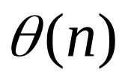
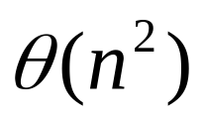
Coefficient representation of Polynomial
Coefficient vector
The operation of evaluating A(x) at a given point x₀
The complexity of Polynomial addition:
The complexity of Polynomial multiplication:

Slide 5
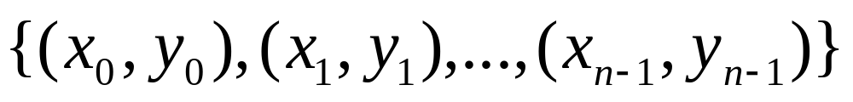
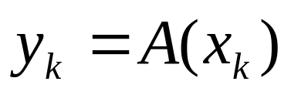
Point-value representation of Polynomial
Point-value representation of Polynomial A(x) is,
such that all of the x_{k} are distinct and a

Slide 6


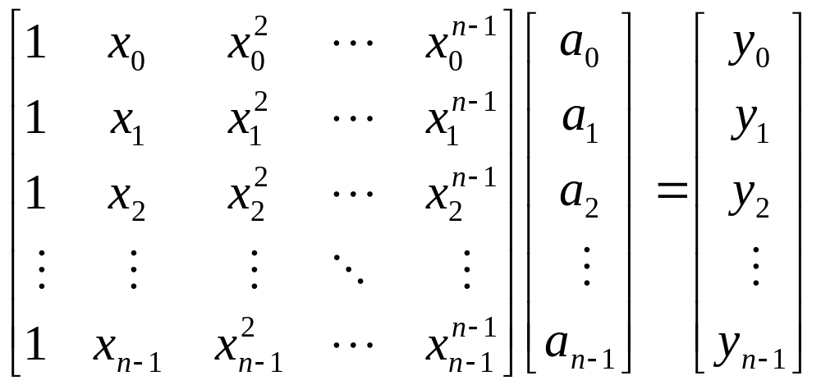
Theorem 30.1 Uniqueness of an interpolating polynomial
For any set
of n point-value pairs such that all the x_{k} value are distinct, there is a unique polynomial A(x) of degree-bound n such that for
Proof:

Slide 7

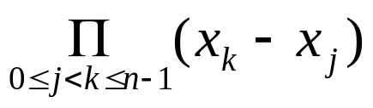
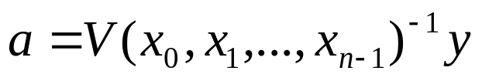
Uniqueness of an interpolating polynomial
The matrix on the left id denoted as , and is known as a Vandermonde matrix, of which the determinant is
The matrix is invertible if the x_{k} are distinct.
Thus, the coefficients can be solved for uniquely given the point-value representation.

Slide 8
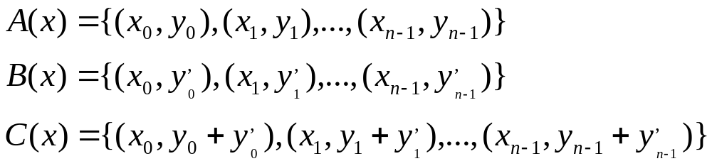
Addition of point-value representation
The complexity of Polynomial addition:

Slide 9
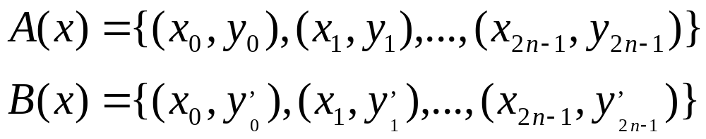
Multiplication of point-value representation
Since the degree-bound of C is 2n,we need 2n point-value pairs for a point-value presentation of C.
Extend point-value of A and B to
The a point-value representation of C is
The complexity of Polynomial multiplication:

Slide 10
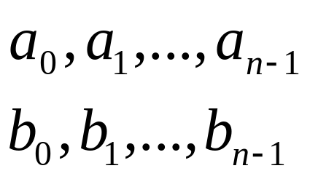
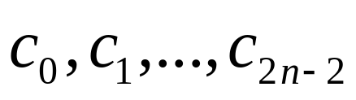

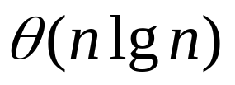

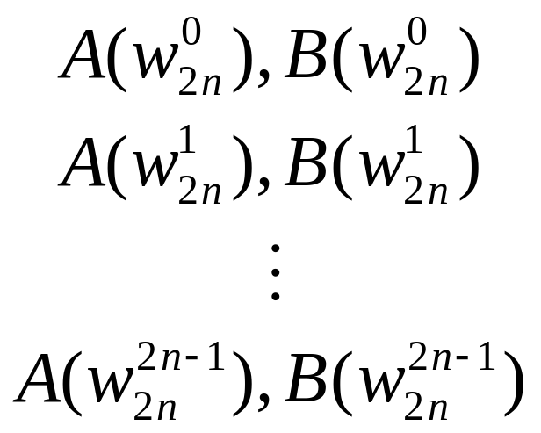
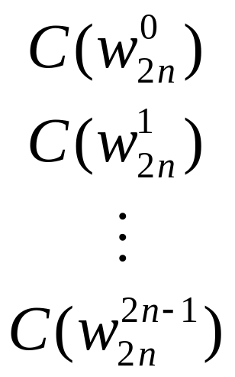

Graphical outline of efficient polynomial multiplication
Ordinary multiplication
Time
Interpolation
Evaluation
Time
Time
Pointwise multiplication
Time

Slide 11
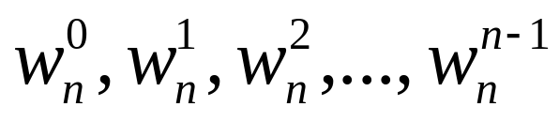
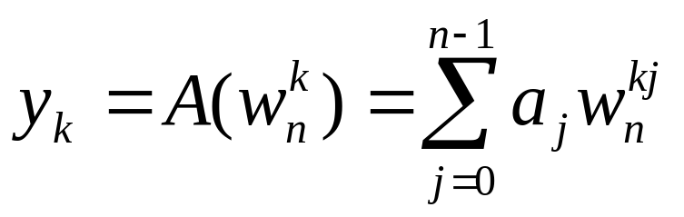
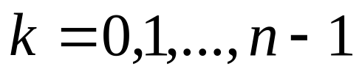
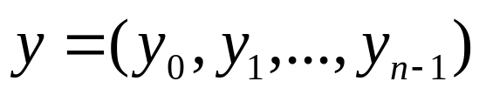
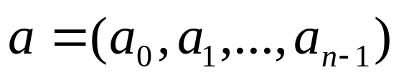
DFT
Evaluating a polynomial,
of degree bound n at
The vector is the discrete Fourier transform of the coefficient vector .

Slide 12
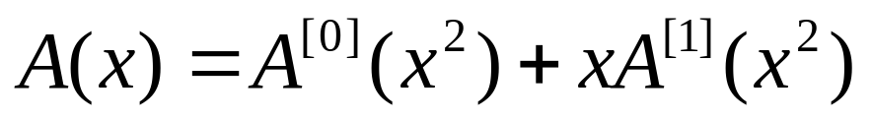
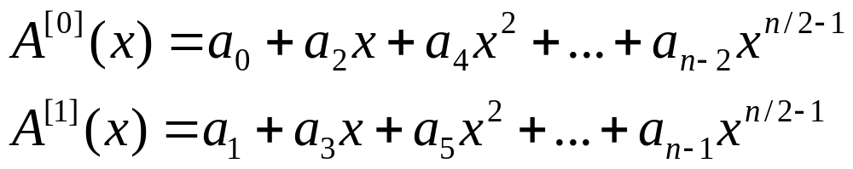
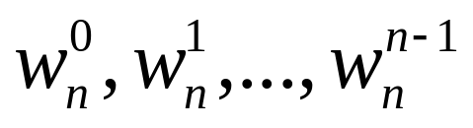
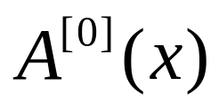
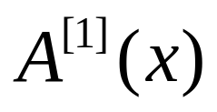
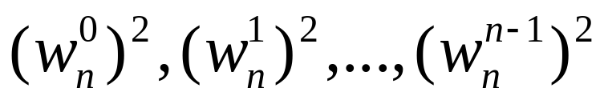
Framework of FFT
The FFT method employs a divide-and-conquer strategy.
Where,
So that, the problem of evaluating A(x) at
reduces to
.
(1)
Evaluating the degree-bound n/2 polynomial
and at

Slide 13
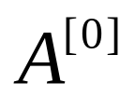
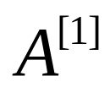
Framework of FFT
(2)
Combing the result.
According to having lemma, the polynomials and of degree-bound n/2 are recursively evaluated at the n/2 complex (n/2)th roots of unity.
The recurrence for the running time is,
.

Slide 14
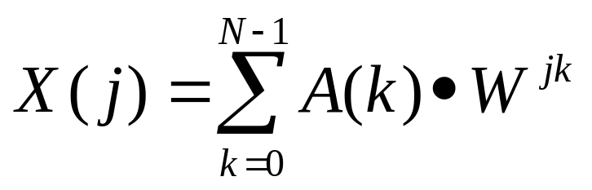
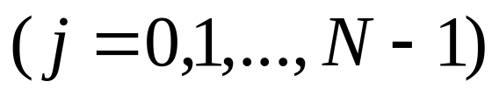
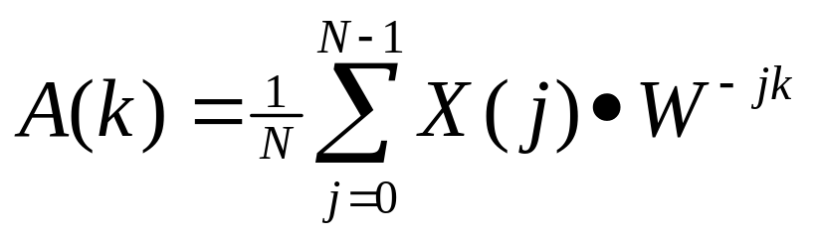
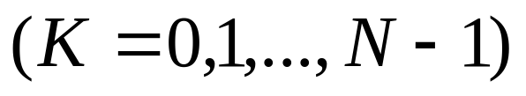
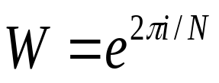
1-D discrete Fourier transform
(1)
(2)
Where,
.

Slide 15
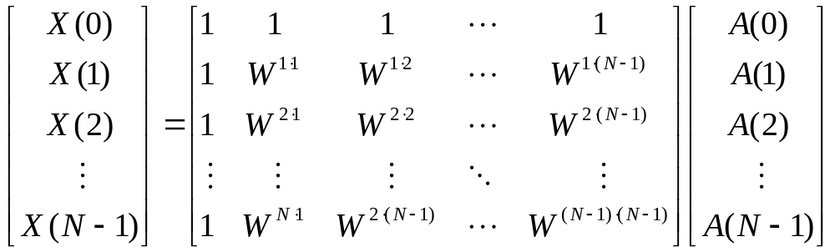

Eq.(1) can be rewritten in matrix form as
(3)
Eq.(3) can be simply denoted as
.

Slide 16
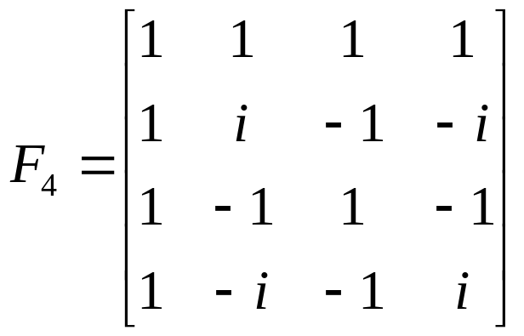
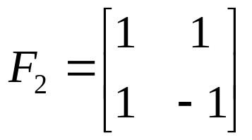



Examples
Please note that,
(a)
(b)

Slide 17
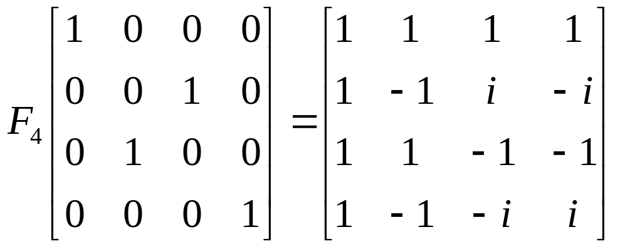
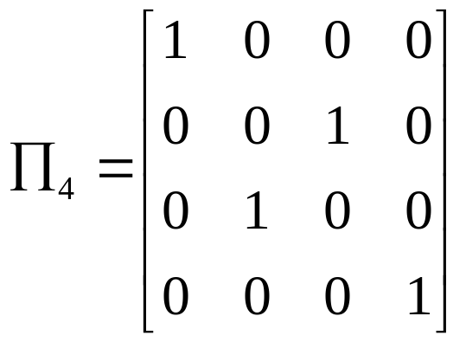
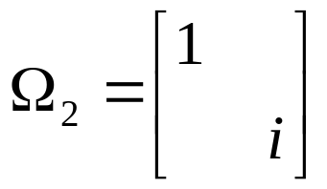
Idea of Fast Fourier Transform (FFT)
By exchanging the 2nd and 3rd column of F₄, we have
Denote,

Slide 18
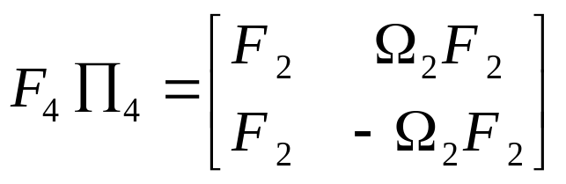
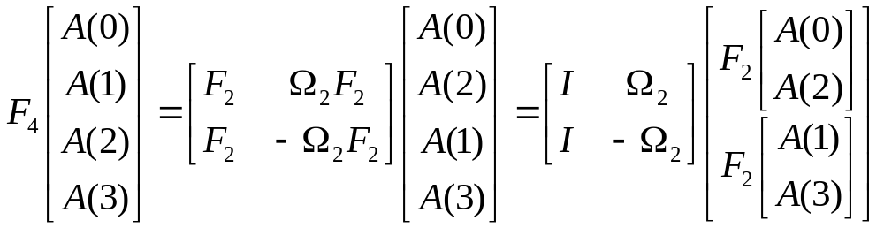
Idea of Fast Fourier Transform (FFT) (con’t)
Then, we have
(4)
Thus,
(5)

Slide 19
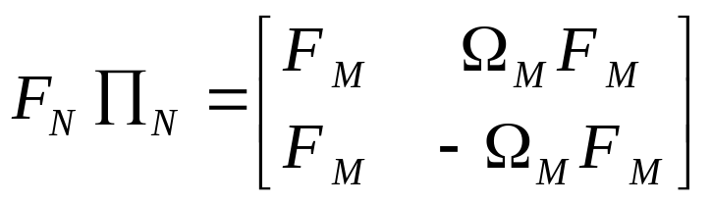

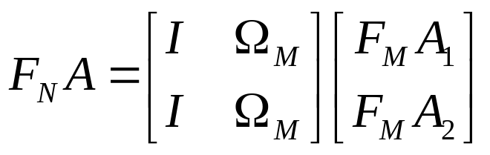


Idea of Fast Fourier Transform (FFT) (con’t)
Similarly, if N=2M,
(6)
Here,
So,
(7)
Here,
and

Slide 20
Idea of Fast Fourier Transform (FFT) (con’t)
One example
If N=8
0,1,2,3,4,5,6,7
0,2,4,6
1,3,5,7
0, 4
2, 6
1, 5
3, 7
0
4
2
6
1
5
3
7

Slide 21





Implementation of FFT
Set
(8)
Here,
and

Slide 22







Implementation of FFT (con’t)
Set
(9)
Then,
(10)
DFT with N points;
DFT with N/2 points.

Slide 23





















Implementation of FFT (con’t)

Slide 24

Implementation of FFT (con’t)
N
/
4
−
1
N
/
4
−
1
A
(
k
)
=
∑
x
(
4
2
lk
+
∑
+
(
2
l
+
1
)
k
l
)
W
x
(
4
l
2
)
W
N
/
2
N
/
2
l
=
0
l
=
0
N
/
4
−
1
N
/
4
−
1
=
∑
x
(
4
l
)
W
lk
+
W
k
∑
x
(
4
l
+
2
)
W
lk
N
/
4
N
/
2
N
/
4
l
=
0
l
=
0
Here,
W
=
e
2
π
i
and
N
/
4
N
/
4

Slide 25




Implementation of FFT (con’t)
Set
N
/
4
−
1
D
(
k
)
=
∑
x
(
4
l
+
2
)
W
lk
N
/
4
l
=
0
Then

Slide 26



Implementation of FFT (con’t)
Similarly, set
N
/
4
−
1
F
(
k
)
=
∑
x
(
4
l
+
3
)
W
lk
N
/
4
l
=
0
Then

Slide 27












Implementation of FFT (con’t)
If N=8, then
all are DFT with 2 points.

Slide 28
















Implementation of FFT (con’t)
bit-reverse
Original index 1, binary code (001)→ (100), output index 4.

Slide 29

Exercise 1
Compute DFT of vector (0,1,2,3)

Slide 30

Solution 1 (FFT):
0,1,2,3
0,2
1,3
0
2
1
3
Notes:
解法 1. 把N=4代入公式（8）(该公式见slide 21)，

Slide 31


Slide 32


Slide 33





